Slide 1
NoSQL Systems

Slide 2

Target Audience
The target audience of this course are those who are:
Fresh graduate hires / Fresher to the subject

Slide 3

Course Agenda
NoSQL Systems

Slide 4

What is a NoSQL Database?
When people use the term “NoSQL database,” they typically
use it to refer to any non relational database
Some say the term “NoSQL” stands for “non SQL” while others say it
stands for “not only SQL”
NoSQL
Either way, most agree that NoSQL databases are databases that store data in a format other than relational tables

Slide 5
NoSQL Database Features
Each NoSQL database has its own unique features
At a high level, many NoSQL databases have the following features :
Flexible schema
NoSQL
Horizontal scaling
Fast queries due to the data model
Ease of use for development

Slide 6


Types of NoSQL Database
Document databases
Key value databases
Column oriented databases
Graph databases

Slide 7
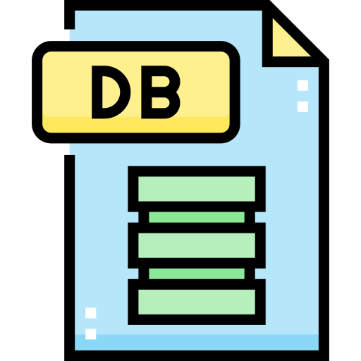
Types of NoSQL Database
Document databases
Stores data in documents similar to JSON (Java Script Object Notation) objects
Each document contains pairs of fields and values
The values can typically be a variety of types
including things like strings, numbers, booleans arrays, or objects

Slide 8
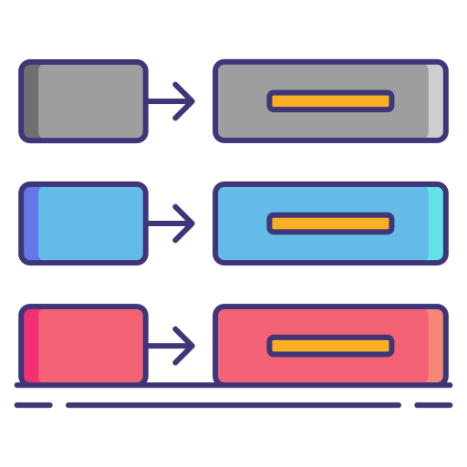
Types of NoSQL Database
Key value databases
A simpler type of database where each item contains keys and values

Slide 9

Types of NoSQL Database
Column oriented databases
Stores data in tables, rows, and dynamic columns

Slide 10

Types of NoSQL Database
Graph databases
Stores data in nodes and edges
Nodes typically store information about people, places, and things, while edges store information about the relationships between the nodes

Slide 11
Difference between RDBMS and NoSQL
RDBMS(SQL) | NoSQL
RDBMS is a row oriented database | NoSQL is column oriented database
RDBMS works with structured and related data | NoSQL works on both unstructured and unrelated data
SQL databases can be scaled only using enhancing software | NoSQL databases can store unlimited data
SQL database are costly affair | NoSQL databases are cheaper
SQL database maintains integrity | NoSQL database sometimes compromises data integrity to handle the large set of data
RDBMS databases are license based | NoSQL databases are open source

Slide 12
When should NoSQL be Used?
When deciding which database to use, decision makers typically find one or more of the following factors lead them to selecting a NoSQL database
Fast paced Agile development
Storage of structured and semi structured
data
Requirements for scale out architecture
Modern application paradigms like microservices and real time streaming

Slide 13
THANK YOU

